Slide 1

Algorithm to find loop-less k-shortest path
CS 575-20 Project
Gunjan R. Mishra(B00865332)

Slide 2
Contents:
1) Project Type
2) Real time issue
3) Algorithm which can solve above real time issue

Slide 3
Project Type:
The Term project is of type 2.
As per Type 2, “Propose a new method or combine existing algorithms (including the ones that are covered or not covered by this course) with implementation for solving a practical problem”.
This project combines existing algorithm to implement real time road/air/transit navigation issue.

Slide 4
Real Life issue:
There are many algorithms(loop-less and with loop variants) for finding shortest path between given fixed source and destination.
This project addresses real life navigation situation, where the optimal shortest path between given fixed source and destination is known. But due to reasons say road repairment work, due to traffic, natural calamity or due to any other reason the optimal shortest path cannot be followed.
In above case, there is need to know other less optimal solutions as well to reach same destination from same source.

Slide 5
Algorithm:
Yen’s algorithm will be the optimal solution to find loop less single source kth shortest paths for a graph with non-negative edge cost.
The algorithm was published by Jin Y. Yen in 1971.
This shortest path algorithm finds the best path, then proceeds to find K − 1 deviations of the best path.

Slide 6
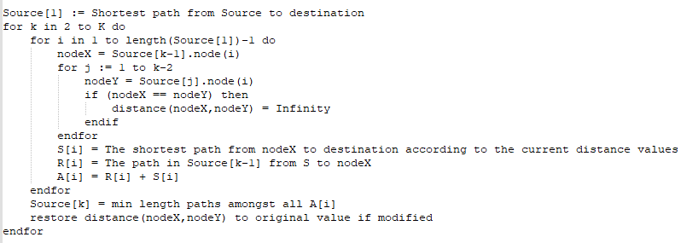
Yen’s Algorithm:

Slide 7
Complexity:
Time complexity
The time complexity of Yen's algorithm is dependent on the shortest path algorithm used in the computation of the all-possible paths(we have used Dijkstra algorithm). Dijkstra's algorithm has a worse case time complexity of O(N^2) but using a Fibonacci heap it becomes O(M+Nlog⁡N),where M is the number of edges in the graph. Since Yen's algorithm makes Kl calls to the Dijkstra in computing the all-possible intermediate paths, where l is the length of intermediate paths. In a condensed graph, the expected value of l is O(log⁡N), while the worst case is N. , the time complexity becomes O(KN(M+Nlog⁡N)).
Space complexity
To store the edges of the graph, the shortest path list S, and the potential shortest path list R, considering edge from every node to every other node in worst case will take N^2 memory addresses. Plus, K times N memory addresses needed for both lists as only k paths will be stored with each path having N nodes. O(N^2+K.N)

Slide 8
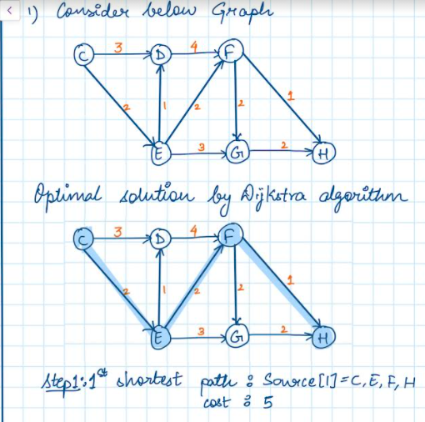
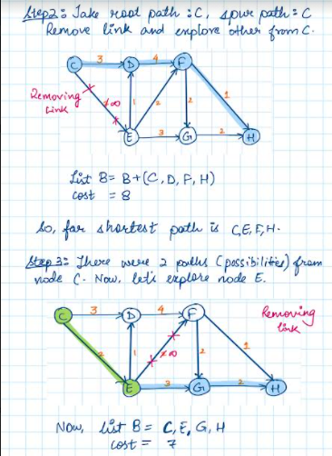
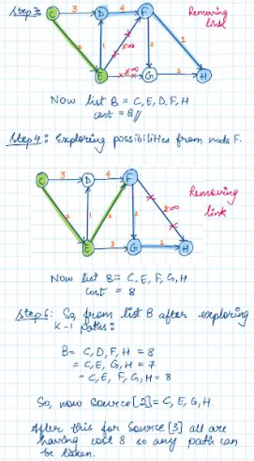
Example:

Slide 9
References:
https://www.linchenguang.com/2018/01/30/Yen-s-algorithm/
https://stackoverflow.com/questions/24653190/how-to-create-a-graph-using-a-csv-file-data
https://en.wikipedia.org/wiki/Yen%27s_algorithm
https://handwiki.org/wiki/Yen%27s_algorithm#Space_complexity

